Slide 1
Security Best Practices for Web Development
Prepared by: Babita khatri
Laxman Malla
Niraj Adhikari
Srishti Sharma

Slide 2
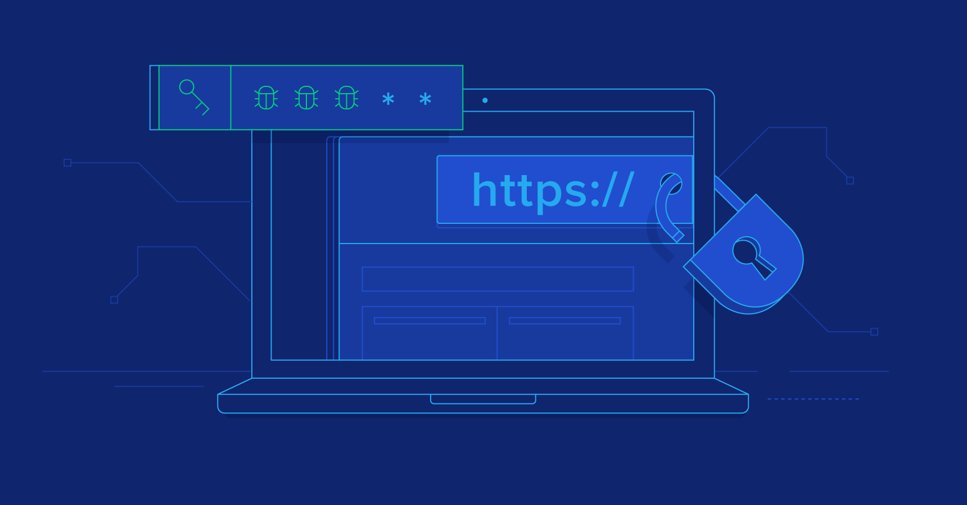
Introduction to Web Security
In web development, security means protecting the website and its users from attacks, data loss, or unauthorized access. It’s a must have, not an extra feature.
Why security is important:
Users enter personal or sensitive data.
Hackers can steal, change, or misuse this data.
A small mistake in code can lead to big security problems
Some common web threats:
SQL Injection
Cross-Site Scripting (XSS)
Broken authentication
Unauthorized access
To prevent these security threats, developers follow some security best practices, like:
Input validation and output encoding
Secure authentication and authorization
Session management
HTTPS and encryption
Error handling
Today, we will focus on the first two major practices:

Slide 3
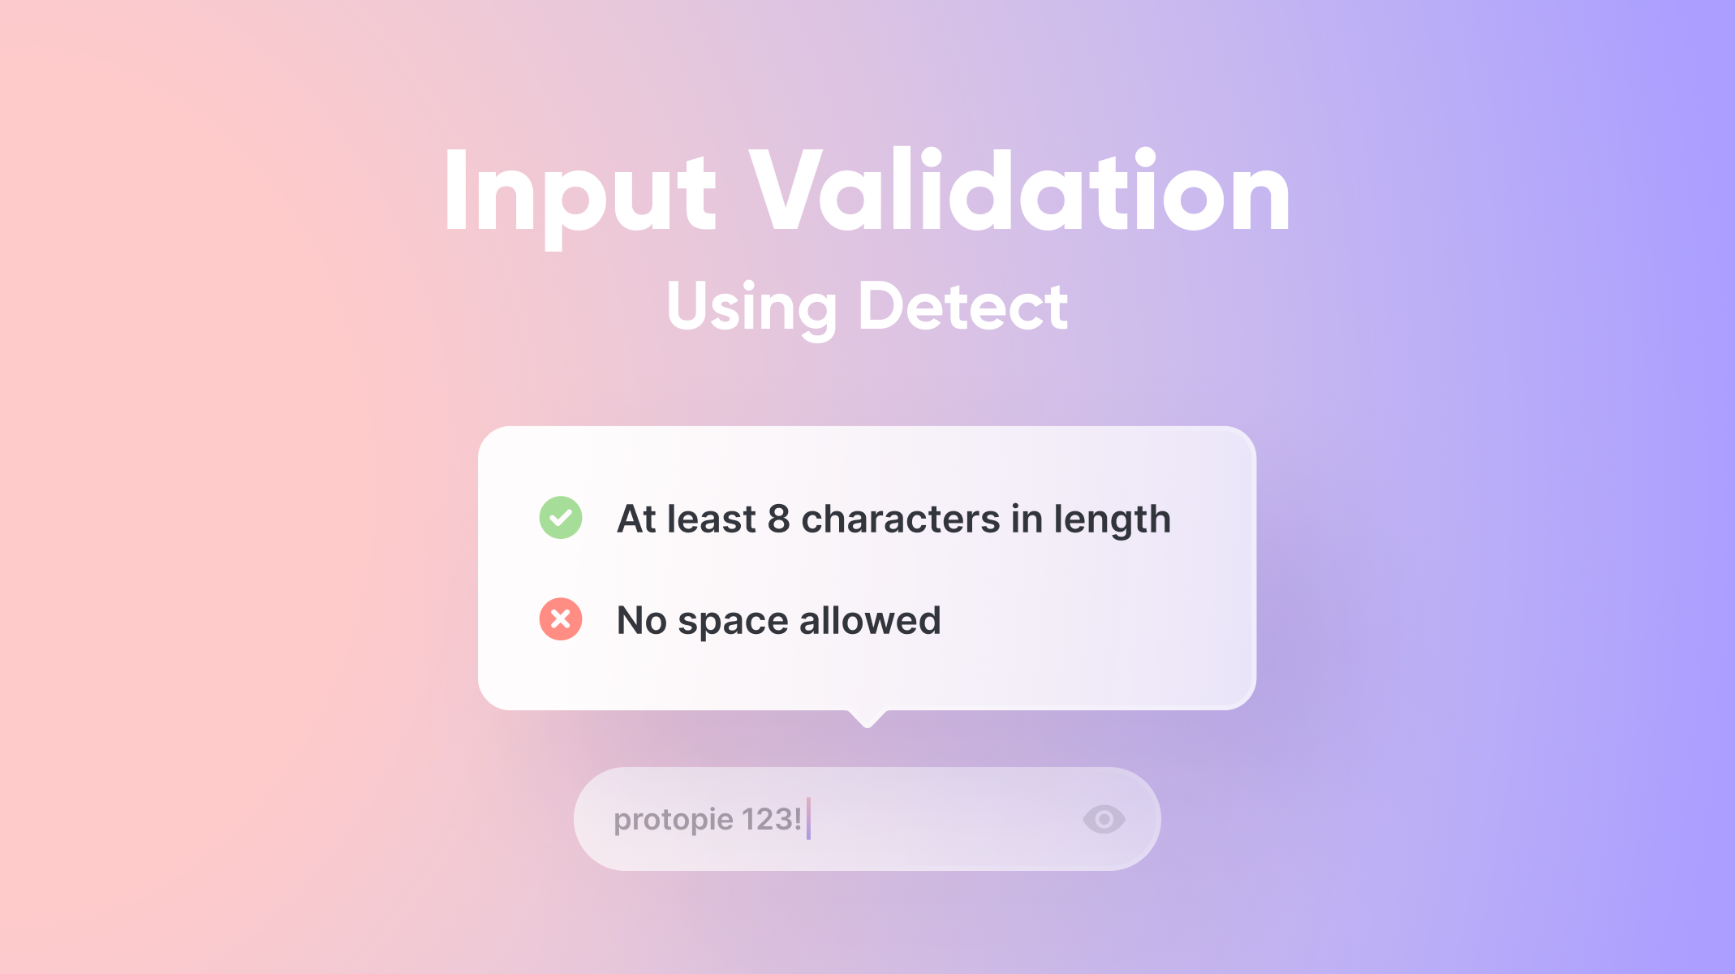
Input Validation
Input validation in Python means checking user input before:
Saving it to a database
Using it in calculations
Sending it to other systems
Why It's Needed
To prevent security risks:
Example: SQL Injection, Code Injection, etc.
To make sure data is in the correct format:
Name must be only letters
Email must follow proper format
Age must be a number
To stop your program from crashing:
If someone enters text where numbers are expected, it should be handled.

Slide 4
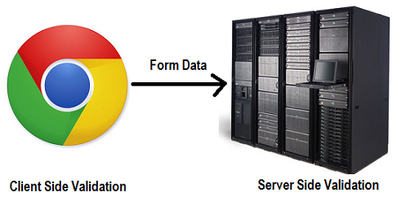
Types of Validation
Client-side Validation (Optional in Python web apps)
Usually done in HTML/JavaScript for quick feedback.
Python (e.g., Flask, Django) still needs server-side validation for security.
Server-side (on the backend using PHP, Java, etc.)
More secure, always required.
Example:
Age should be a number between 1–100.
Email should match an email format.

Slide 5
Best Practices for Input Validation in Python
Treat All User Input as Untrusted
Never assume user input is safe. Validate everything—whether it's from a web form, command line, file, or API.
Validate Format, Length, and Type
Ensure the input matches the expected type, is within the length limits, and follows the correct format.
Use Regular Expressions for Complex Formats
Use python re module to validate patterns like email, phone number etc
Set Clear Input Constraints
Limit input length (e.g., max 20 characters)
Restrict characters (e.g., allow only letters)
Avoid optional inputs unless necessary

Slide 6
Output Encoding
Output encoding is the process of converting special characters in user input into safe equivalents before displaying that input on a webpage or any user interface.
It ensures that input like <script>, <, >, & is shown as text, not interpreted as code by the browser.
It neutralizes any embedded code that could be malicious.
Why is Output Encoding Important?
Prevents Cross-Site Scripting (XSS) Attacks: Attackers try to inject scripts or HTML that browsers will run, stealing data or hijacking user sessions.
Protects User Data and Privacy: Encoding stops these malicious scripts from executing, safeguarding both users and your website.
Maintains Website Integrity: Keeps your web pages safe from unintended behavior caused by injected code.
Example: If a user enters <script>alert(“hi”)</script>, the website should show it as plain text, not execute it.
How to do it: Use encoding functions like in PHP. Encode special characters: etc.

Slide 7
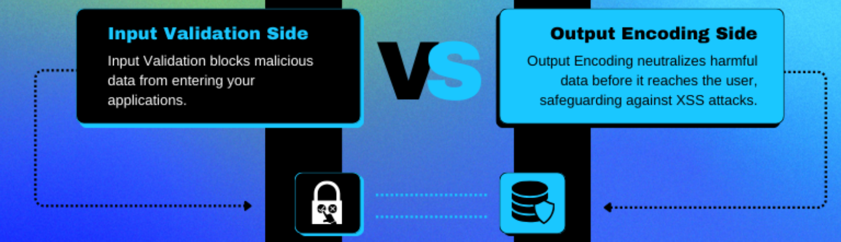
Output Encoding
Best Practices
Always encode data when displaying untrusted input.
Combine output encoding with input validation to strengthen security.
Use context-aware encoding: encode differently for HTML, URLs, JavaScript contexts.
Avoid disabling auto-escaping features in web frameworks unless absolutely necessary.

Slide 8
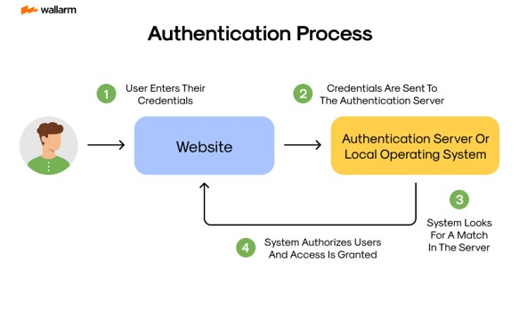
Secure authentication and authorization
Authentication Authentication is the process of verifying the identity of a user, device, or system before giving access to data or services.
It helps prevent unauthorized access and protects sensitive information.
Methods include passwords, multi-factor authentication (MFA), biometrics, OTPs, and security tokens.
When is Secure Authentication Done?
It is usually done before giving access to any system or service.
Phases:
1. Identity claim
User enters a username or ID
2. Credential submission
User provides a password, OTP, or biometric
3.Verification
System checks if the credentials are correct
4.Access control
If verified, access is granted; if not, access is denied

Slide 9
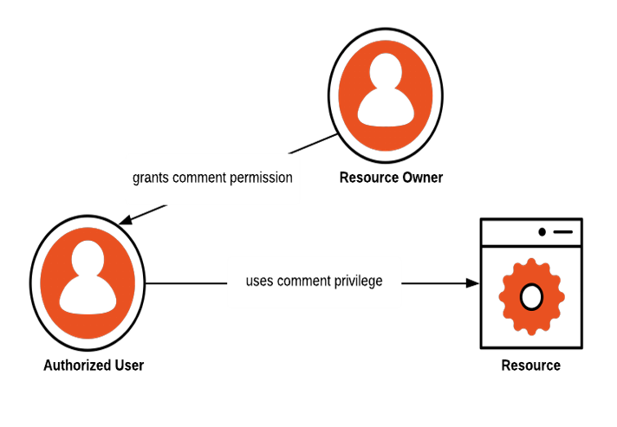
Secure authentication and authorization
Authorization Authorization means giving someone permission to do something.
It’s like getting an “okay” from the person in charge before you take an action.
For example, you need authorization from a shop owner before putting up your paintings in their store.
Authorization Process in Points:
User logs into the system (after authentication).
System checks what the user is allowed to access.
Permissions are matched with the user’s role or level.
Access is granted or denied based on rules.
Only allowed actions or resources can be used by the user.
This section focuses on protecting a web application by:
Ensuring only authorized people can access it (authentication), and
Controlling what each user is allowed to do (authorization).

Slide 10
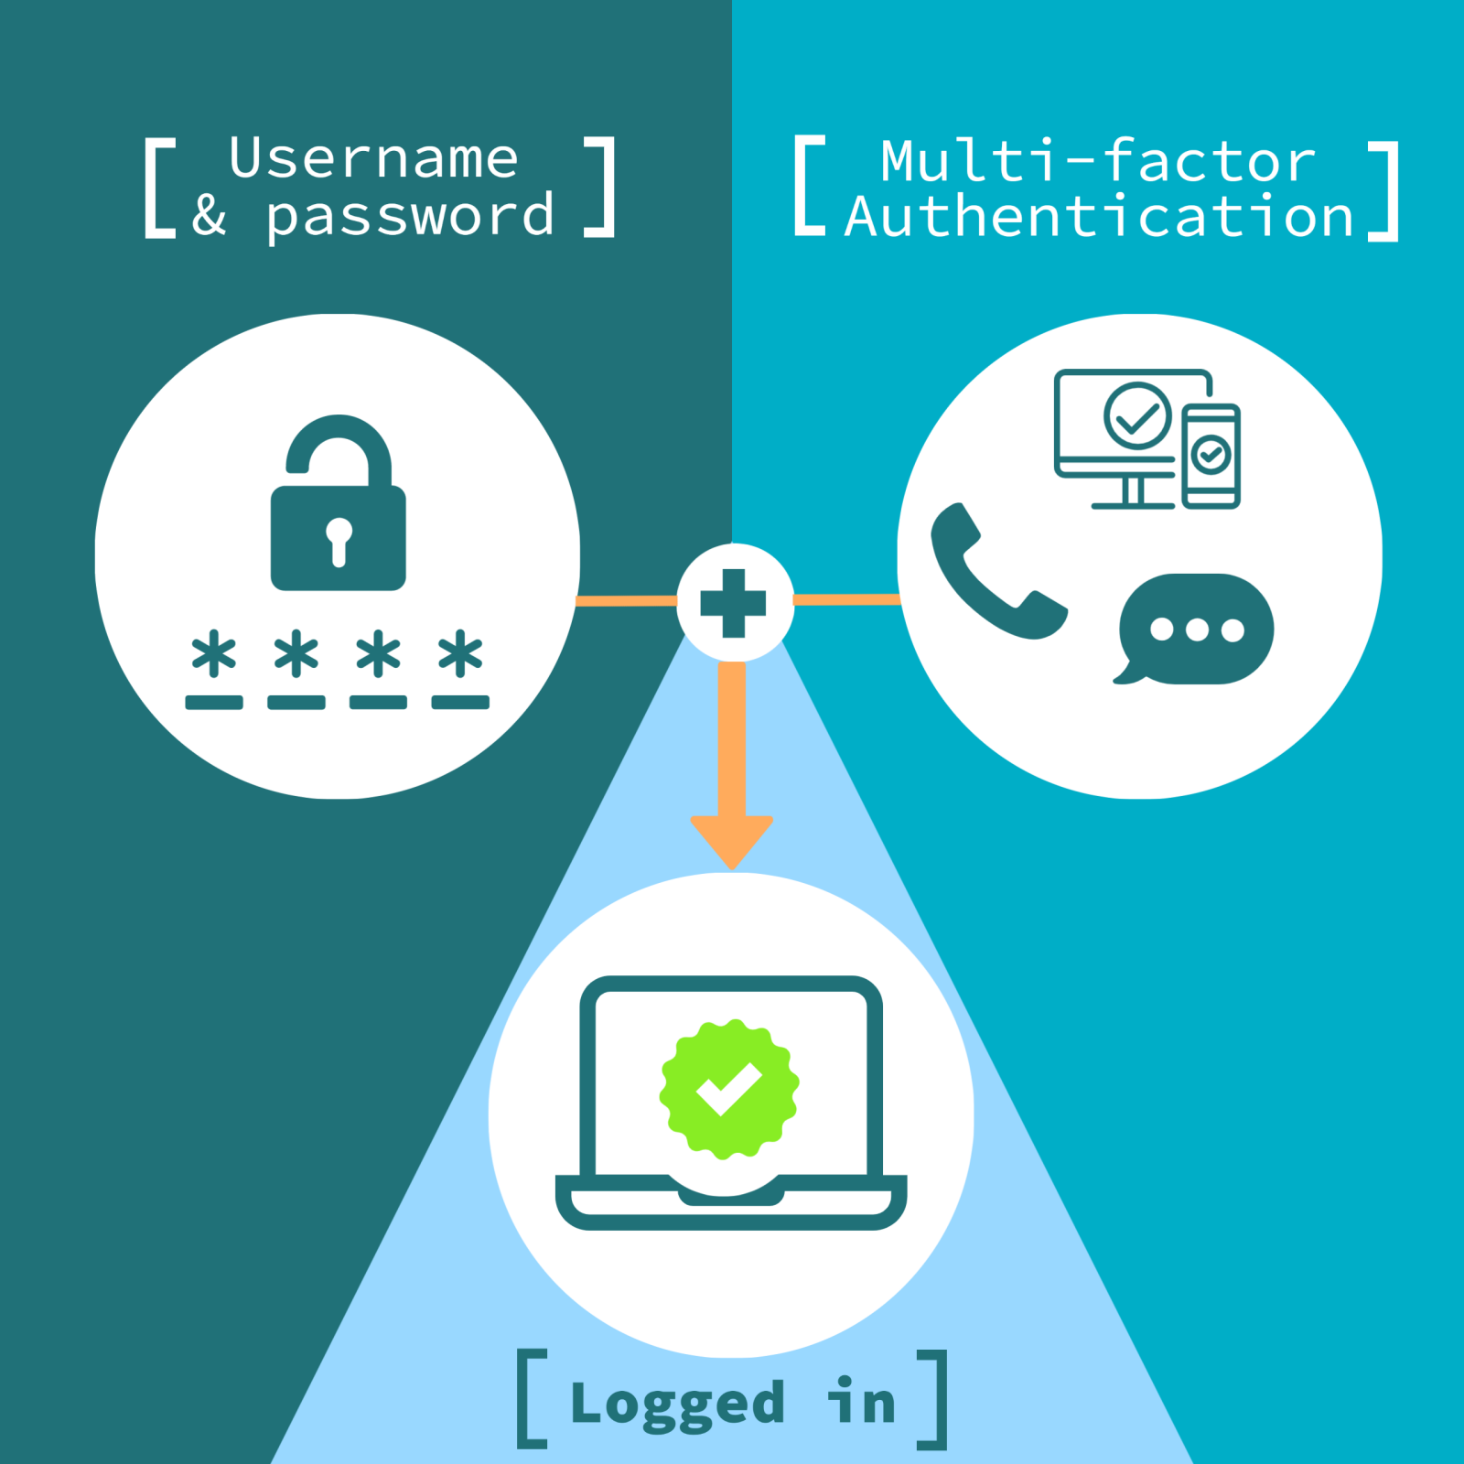
Secure authentication and authorization
Let's go through the key parts: 1. Multi-Factor Authentication (MFA)
MFA means using more than one method to confirm a user's identity.
Why to use MFA?
If the password is stolen, the attacker still can’t log in without the second factor.
Common MFA methods:
Something we know (password)
Something we have (OTP, mobile app)
Something we are (fingerprint, face)
Best Practice: Use MFA for admin logins and important accounts.
Example
After entering our password, we also receive a code on our phone.

Slide 11
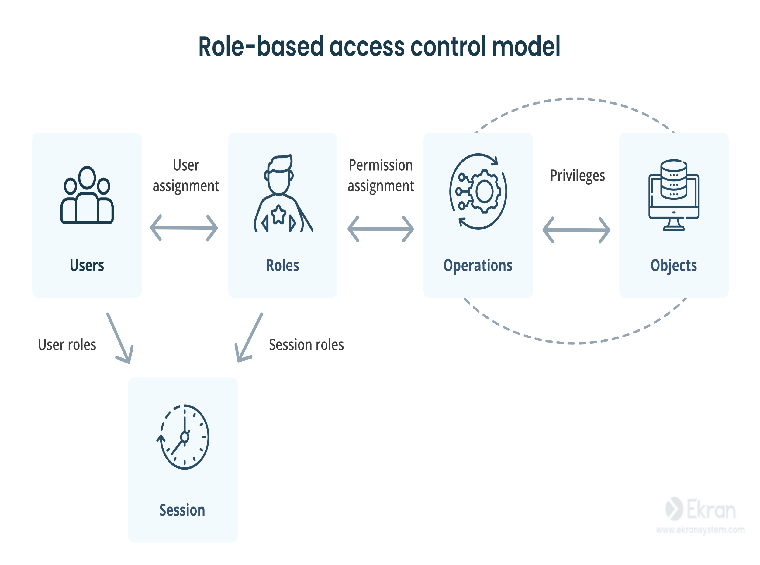
Secure authentication and authorization
2.Role-Based Access Control (RBAC) Role-Based Access Control (RBAC) is a way to give users access based on their job roles.
Instead of giving permissions one by one, users are grouped by role (like admin, HR, or employee), and each role has set permissions.
Key Points:
Users are assigned roles (like admin, editor, viewer).
Roles have permissions (like read, write, delete).
Users get permissions through their assigned roles.
It’s easier to manage access for groups instead of individuals.
Helps improve security and control in a system.
Example
Admin: can add or remove users
Editor: can edit content
Viewer: can only view content
RBAC ensures that people only do what they’re allowed to do based on their role.

Slide 12
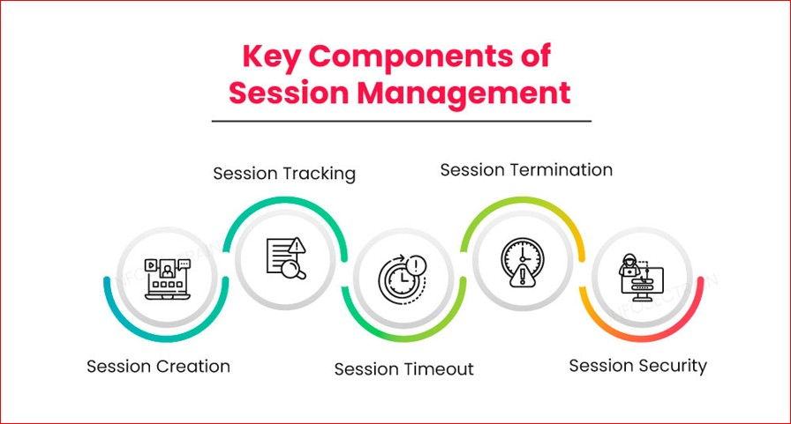
Secure authentication and authorization
3.Secure Session Handling Secure session handling is essential for protecting user privacy and data integrity in web applications. After a user logs into a website, the system needs a way to remember them as they browse different pages. This is done using a session, which usually stores a unique session ID in a cookie.
Session Handling Means:
Use long, random, and unpredictable session IDs, so attackers can’t guess them.
Set important cookie flags:
HttpOnly: JavaScript running in the browser cannot access the cookie, reducing the risk of theft through XSS(Cross site scripting) attacks.
Secure: The cookie is sent only over HTTPS, keeping it safe from being intercepted on unsecured networks.
Set a timeout for inactive sessions (e.g., log the user out automatically after 15 minutes of inactivity).
Always destroy the session on logout, so the old session ID cannot be reused.

Slide 13
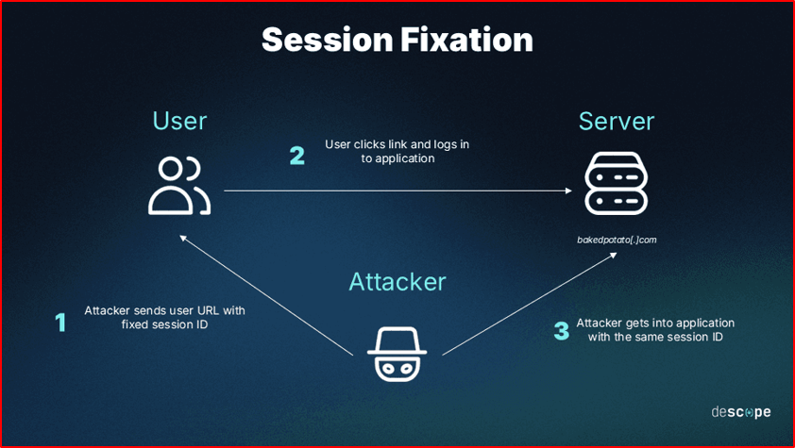
Secure authentication and authorization
4. Session Fixation and Hijacking Prevention 🔒 Session Fixation An attacker tricks the user into using a predefined session ID, so once the user logs in, the attacker can hijack the session.
Example: The attacker sends the victim a link like: https://example.com/login?sessionid=123456
If the website accepts that session ID, once the victim logs in, the attacker can use the same ID to access the account.
✅ Prevention Tips:
Always generate a new session ID after a successful login.
Reject any session IDs coming from URLs or untrusted sources.
Use secure cookie settings (HttpOnly, Secure) to prevent manual tampering.

Slide 14
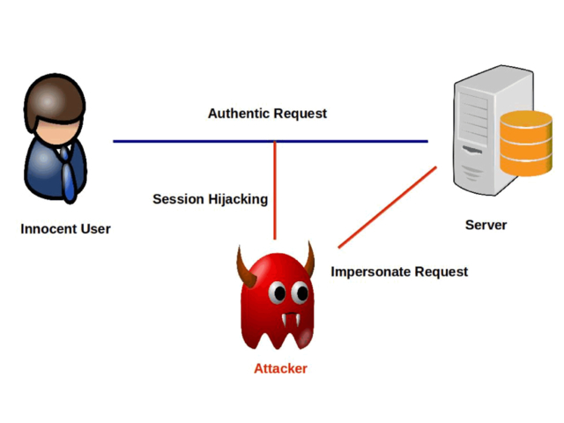
Secure authentication and authorization
4. Session Fixation and Hijacking Prevention 🔒 Session Hijacking An attacker steals an active session ID, usually through:
Sniffing unencrypted traffic (on public Wi-Fi)
Exploiting XSS vulnerabilities to read cookies
Using malware to grab session data
Once stolen, the attacker can impersonate the user.
✅ Prevention Tips:
Use HTTPS everywhere, especially for login and sensitive actions.
Implement IP address checks or device fingerprinting to detect changes in the session environment.
Rotate session IDs regularly (e.g., after login or privilege changes).
Monitor for abnormal session behavior, like logins from different locations.

Slide 15
Secure authentication and authorization
4. Session Fixation and Hijacking Prevention 🔒 Session Hijacking Simple Example:
Session : Digital ID card
Session Fixation : Attacker gives fake ID
Session Hijacking : Attacker steals real ID
Solution :Keep ID random, hidden, replaced after login.

Slide 16

Secure authentication and authorization
5. Error Handling and Logging Error Handling It means showing safe and user-friendly messages when something goes wrong, without revealing technical details to the user. Instead of showing a technical error (which can confuse users or help hackers), we show a friendly, simple message like “Something went wrong.”
Why is it important?
Attackers can use error messages to discover system vulnerabilities.
Users may get confused by technical terms.
Best Practices:
Show generic error messages to users (e.g., "Something went wrong. Please try again.").
Hide details like SQL errors or file paths.
Use try-catch blocks in your backend to handle exceptions properly.
Example:
Instead of showing “NullPointerException at line 45 in LoginService.java” we can show “Unexpected error occurred. Please try again”.

Slide 17
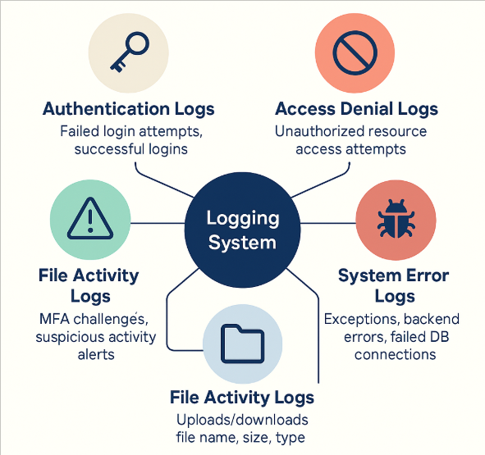
Secure authentication and authorization
5. Error Handling and Logging Logging It means recording important activities and errors inside the system for future review by developers or admins. It’s like our system keeping a diary of important events like logins, errors, suspicious activity, etc. These logs are only for admins or developers, so they can track issues or attacks, and fix problems later.
Why is it important?
Helps detect suspicious activities (like multiple failed login attempts).
Makes it easier to fix bugs and security issues.
What to log?
Failed login attempts
Unauthorized access tries
System errors
File upload attempts
Note: We should always protect logs from unauthorized access, as they may contain sensitive info.

Slide 18
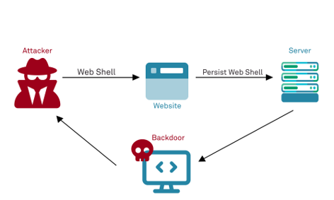
Secure authentication and authorization
6. Secure File Uploads Definition: Secure file upload is the safe handling of files sent by users to ensure they do not contain harmful content or cause system damage.
Why it matters?
Attackers may upload dangerous files (e.g., scripts or viruses).
Large files or unsafe formats can crash or hack the system.
What’s the risk? Letting users upload files can be dangerous if:
Malicious files are uploaded like .php, .exe, or scripts. (.php can run code on our server; .exe can be a virus or malware; .js or scripts can steal our data or hijack sessions)
Very large files are uploaded to crash the server
Files are executed instead of just stored

Slide 19

Secure authentication and authorization
6. Secure File Uploads Best Practices for Secure File Uploads: 1. Allow only specific file types: e.g: .jpg, .pdf, .png 2. Rename uploaded files: Avoid keeping the original name (it might contain scripts). 3. Scan files (optional): Use antivirus or malware scanners. 4. Check file size: Set a max size limit (e.g., 5MB). 5. Store files in a safe location: Outside of the public folder to prevent direct access. 6. Check file content type Don’t trust just the extension; check the MIME type too.
Real World Example: Suppose a user uploads report.pdf, but the attacker renames a script as report.pdf.php. If not validated properly, the server may execute the script and expose our system.
Note: Secure file uploads are critical for forms, resumes, images, and document-based systems.

Slide 20
Conclusion
Web security is not optional; it's essential for protecting users, data, and business integrity. By following proven best practices, developers can significantly reduce the risk of attacks and create safer applications.
Key Takeaways:
Input Validation & Output Encoding: Prevent malicious data entry and code injection.
Authentication & Authorization: Ensure only verified users get appropriate access (use MFA and RBAC).
Secure Session Management: Protect sessions from fixation and hijacking.
Error Handling & Logging: Avoid revealing sensitive system info and track abnormal activities.
Secure File Uploads: Block harmful or oversized files and validate all uploads thoroughly.
Together, these practices form a strong security foundation that protects your application from common threats and builds user trust.

